Slide 1
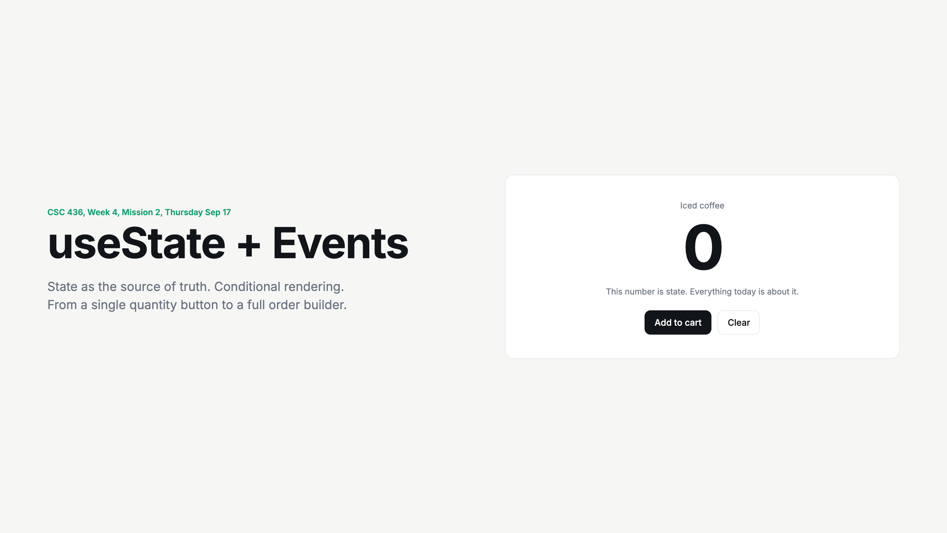
Notes:
Have a student hit Add to cart. Ask: where does that number live? Nobody will know yet. That is the hook.

Slide 2
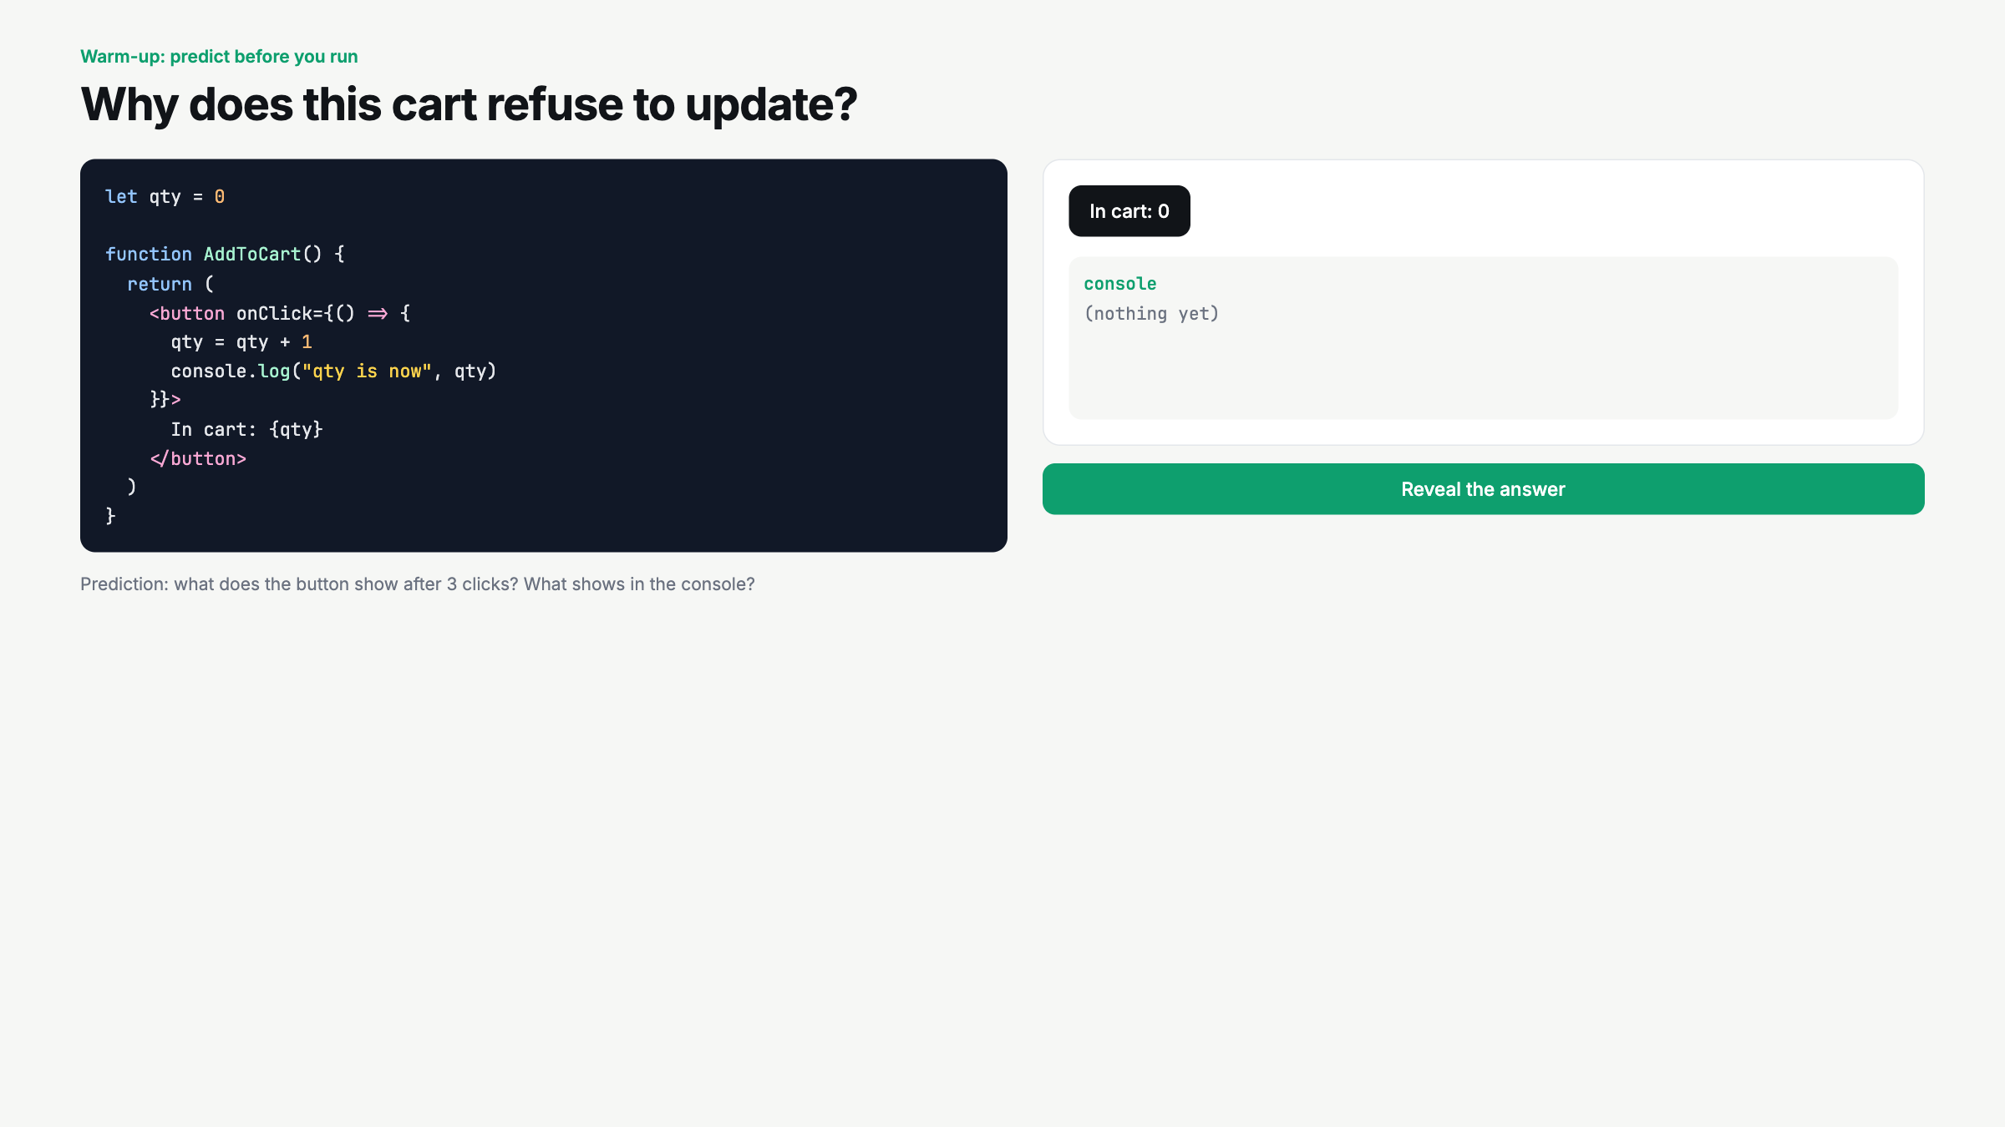
Notes:
Predict out loud before any click. Get a vote on what the button will show. Then click three times. Console moves, button does not. Reveal only after they argue.

Slide 3
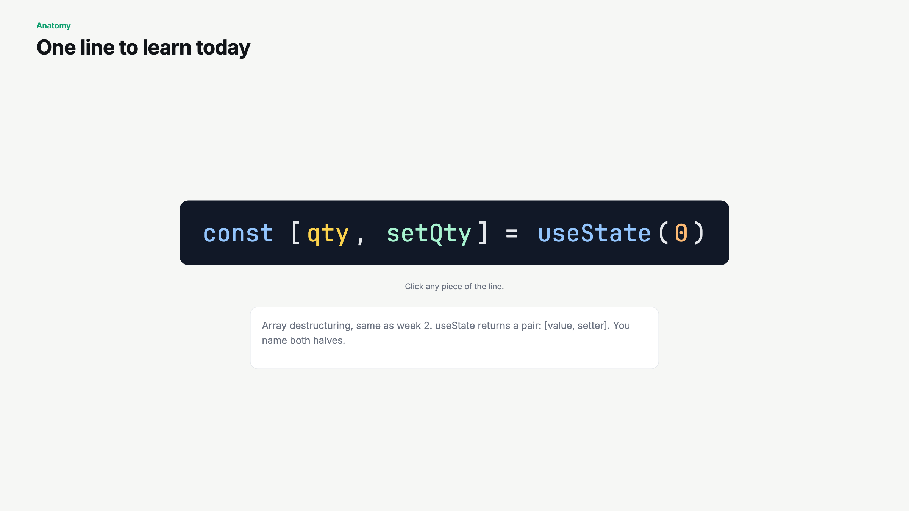
Notes:
Click each part in order: 0, useState, qty, setQty. Tie destructuring back to week 2. Say the hook rule twice.

Slide 4
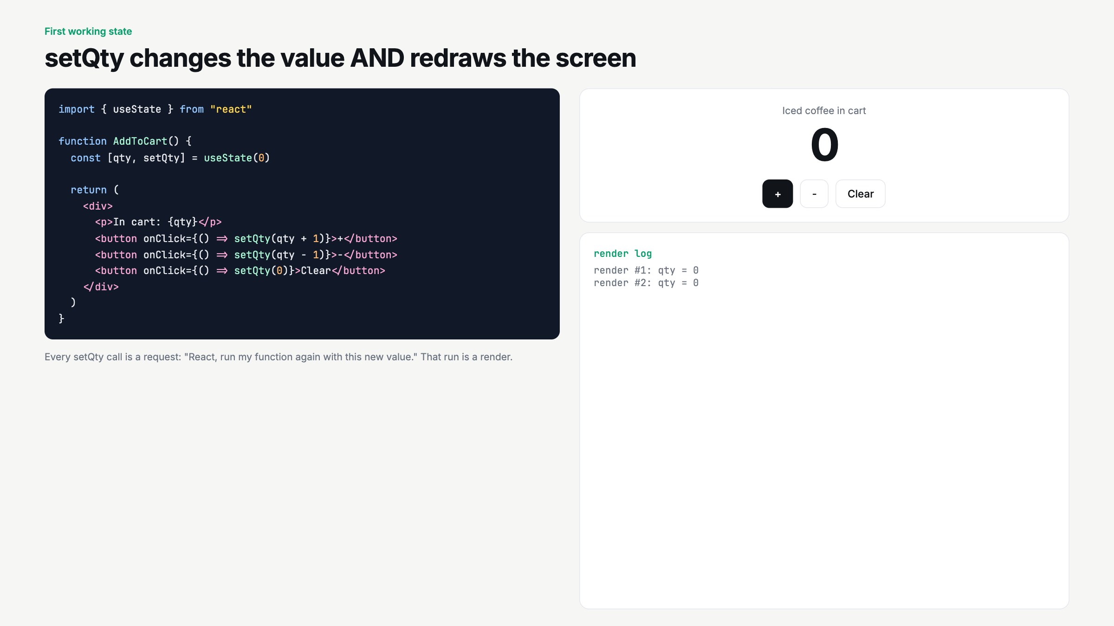
Notes:
Watch the render log. Each click is a full function run. Ask: is qty the same variable across renders? No. It is a fresh photo each time.

Slide 5
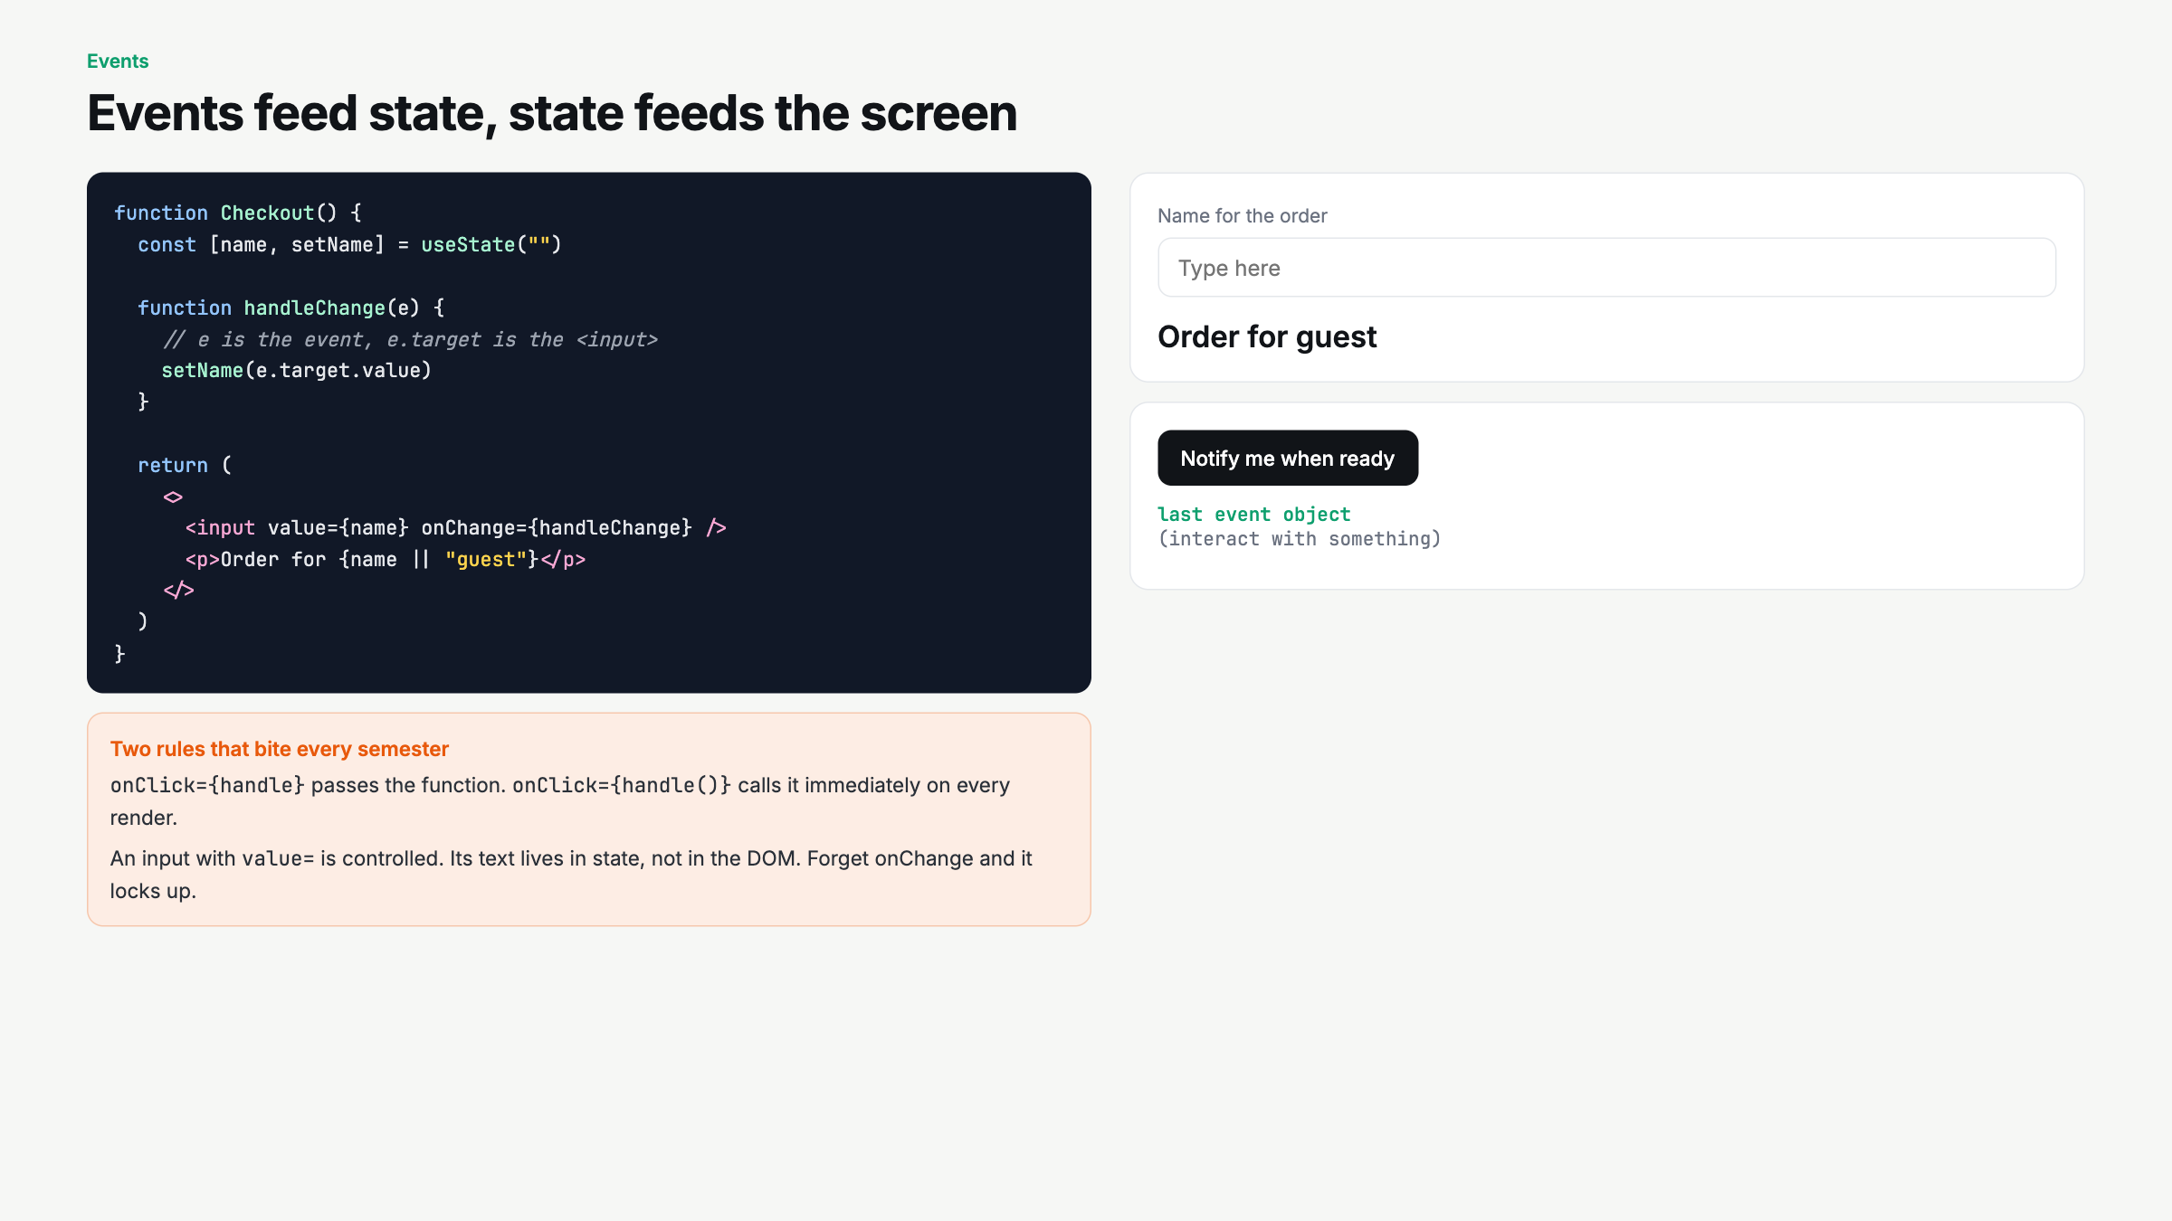
Notes:
Type slowly so they see value flow input to state to text. Deliberate mistake beat: write onClick={handle()} live and show the console spam.

Slide 6
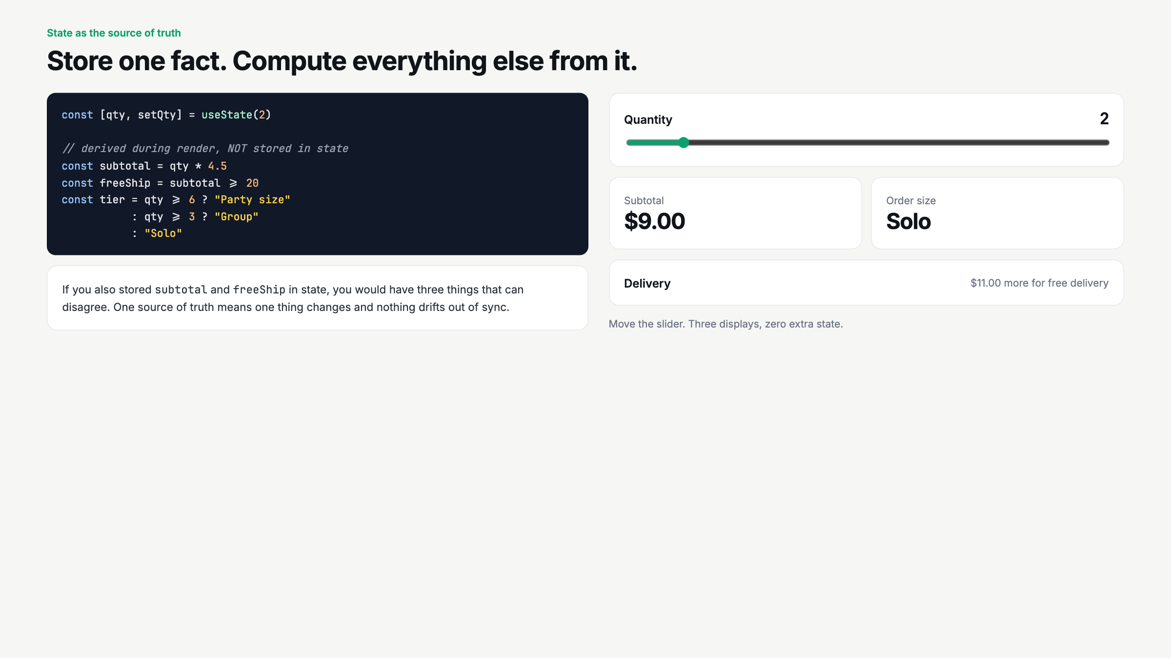
Notes:
Drag the slider. Ask what would break if subtotal was its own state. Answer: you could forget to update it. Phrase: store facts, compute views.

Slide 7
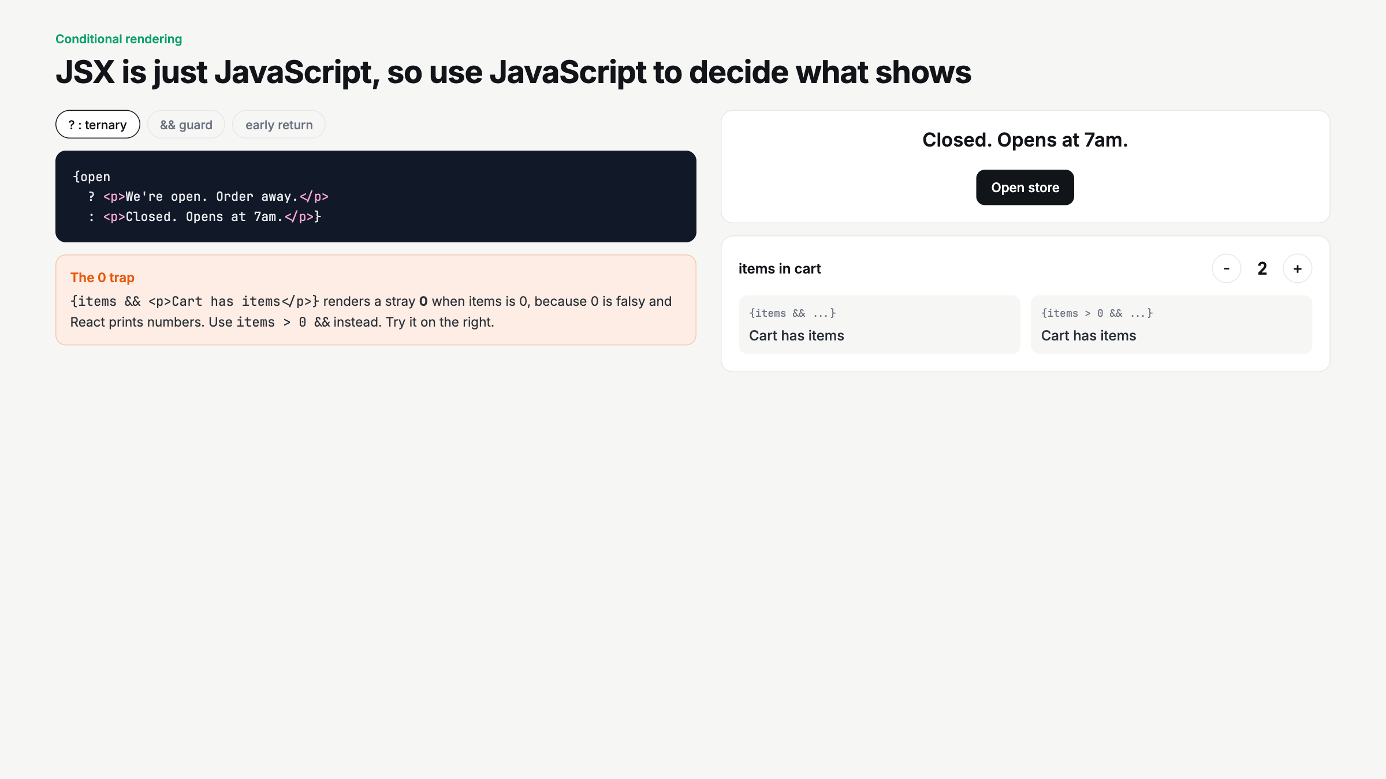
Notes:
Cycle the three syntaxes on the same store status. Then the 0 trap. Set items to 0 and let them find the stray zero on screen.

Slide 8
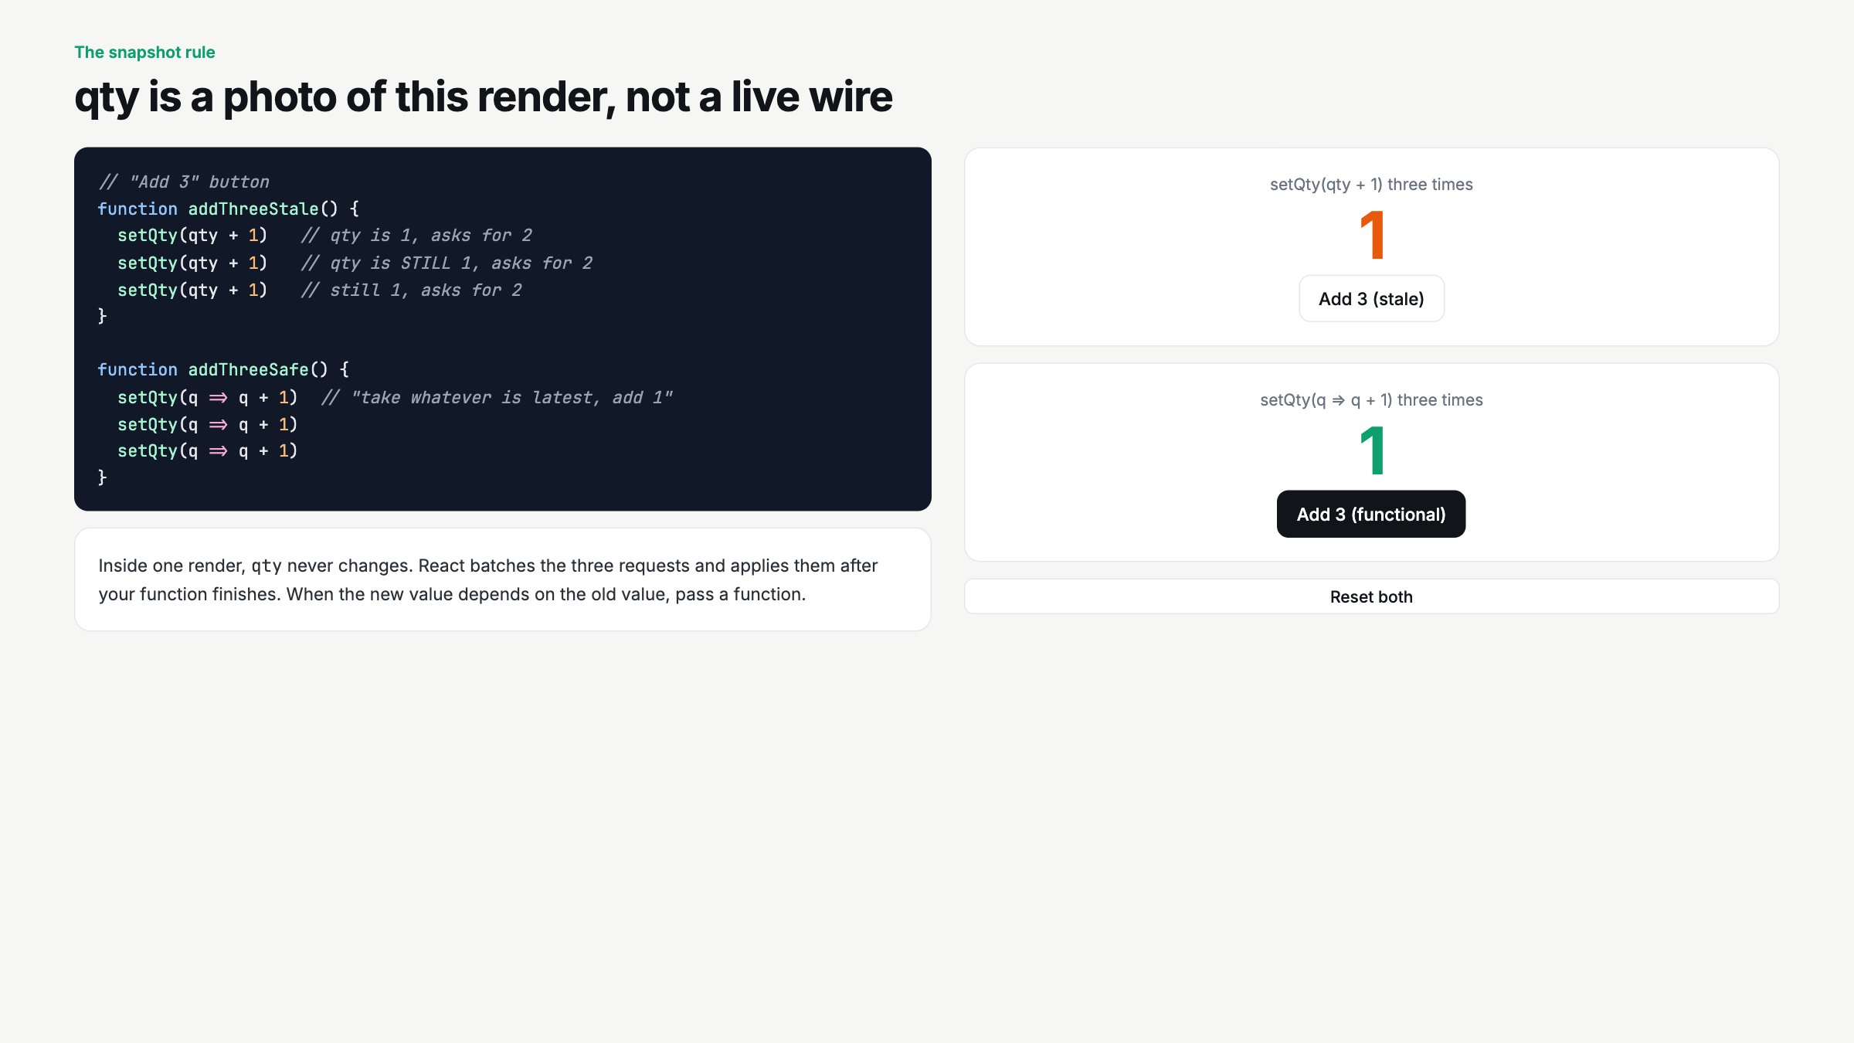
Notes:
Click stale first. Only goes up by 1. Then functional. Explain batching in one sentence. This is the trap that will bite them in Silver.

Slide 9
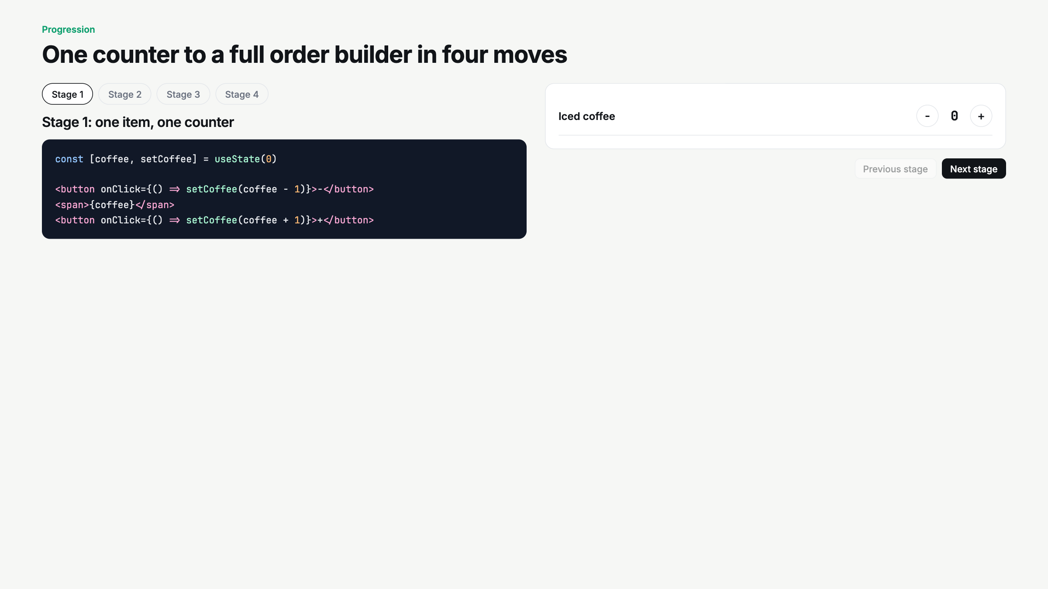
Notes:
This is the live-code script. Stage 1 to 4 in order. At stage 2, mutate cart.coffee += 1 on purpose and show nothing re-renders. Then spread.

Slide 10
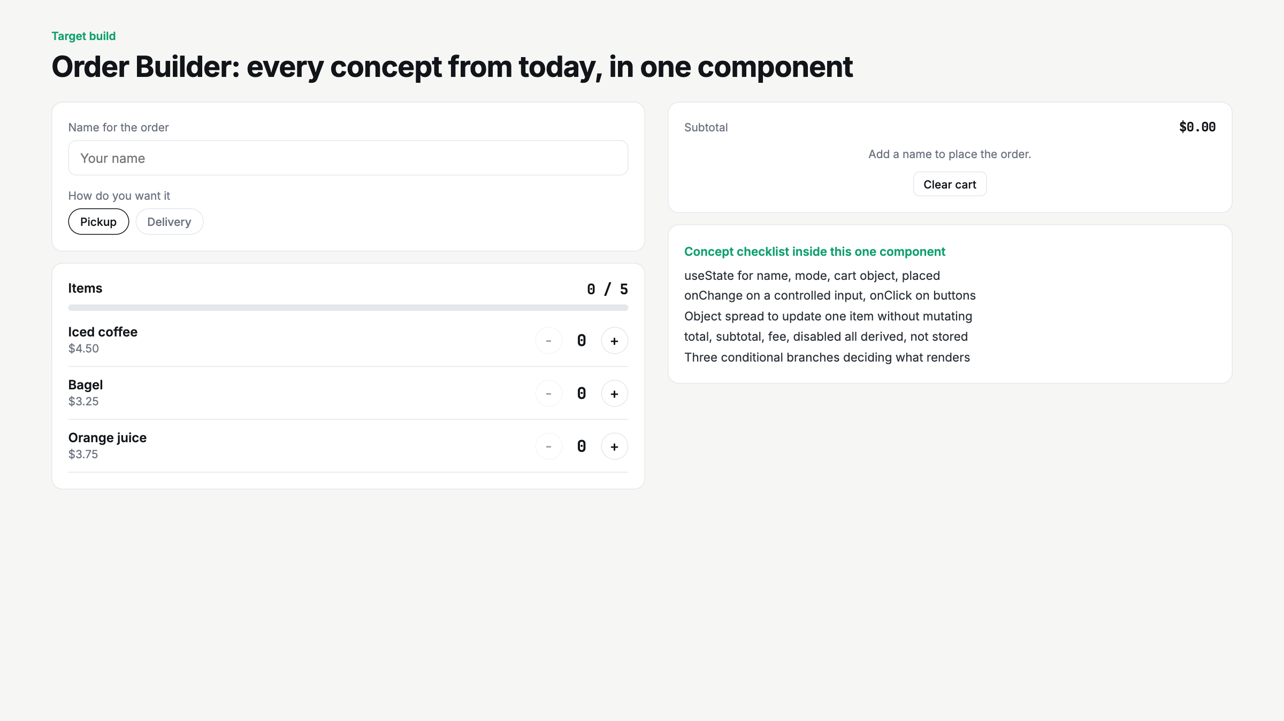
Notes:
Place an order with a student's name. Walk the concept checklist. This is exactly what the assignment asks for.

Slide 11
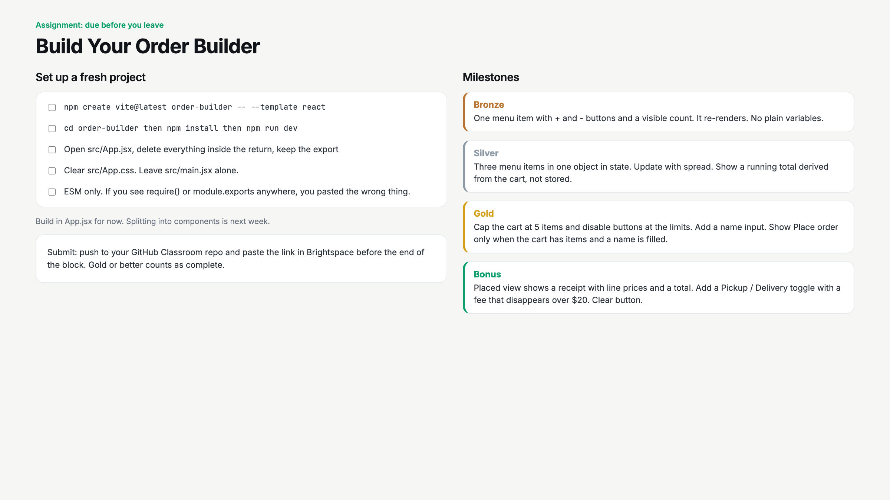
Notes:
Read the ESM line out loud. Start a 20 minute timer for the build block. Circulate for the mutation bug and the 0 trap.

Slide 12
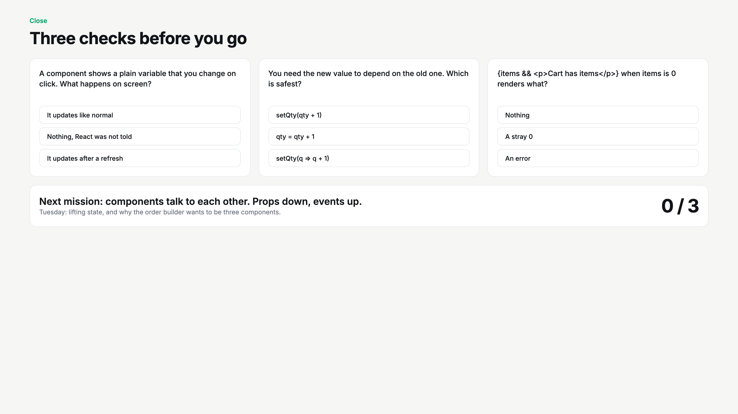
Notes:
Hands up per question. Anyone who misses Q2 stays on the snapshot rule for two more minutes. Tease Tuesday.

